Slide 1

JAZA INCLUSIVE FINANCE INITIATIVE
Improving livelihoods
through inclusive
enterprise and markets
A locally embedded development delivery platform combining finance, enterprise capability, market systems and evidence.
DEVELOPMENT DELIVERY CAPABILITY • 2026
Jaza field engagement | Kenya, 2026
Notes:
[Sources]
- Internal: JIFI Capability Deck 2026
- Internal: Jaza Capital JIFI Data Collection and Feasibility Report, August 2026
[/Sources]

Slide 2
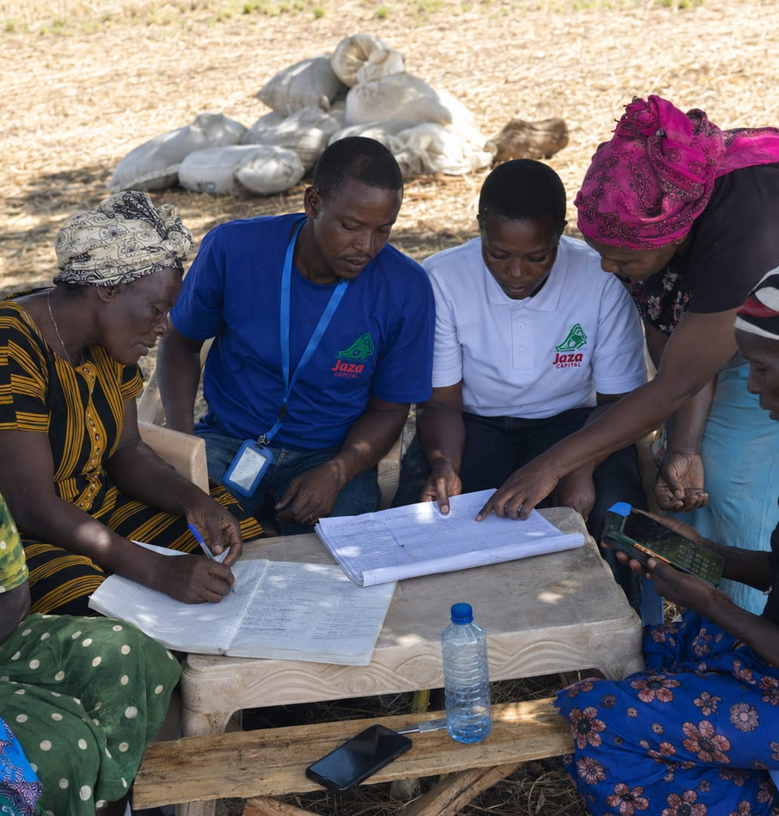
Why JIFI: access alone does not secure better livelihoods
The development challenge is to convert finance into productive, resilient and inclusive economic opportunity.
Financial vulnerability
Enterprise constraints
Savings buffers, debt stress and irregular income constrain investment and resilience.
Weak records, limited capability and unsuitable finance restrict sustainable business growth.
Fragmented markets
Unequal opportunity
Enterprises struggle to reach buyers, suppliers, standards and reliable transaction pathways.
Women, young people and underserved communities face additional barriers to participation and benefit.
Development implication
Programmes must combine suitable finance, savings and investment pathways with enterprise support, market access, inclusion, resilience and credible evidence of improved livelihoods.
Enterprise engagement | Kenya, 2026
Notes:
[Sources]
- Internal: JIFI Capability Deck 2026, slides 2–3
- Internal: Jaza Capital JIFI Data Collection and Feasibility Report, sections 4, 6 and 10
[/Sources]

Slide 3
What JIFI is
A Kenya-based development delivery partner for inclusive enterprise, livelihoods and value-chain programmes.
Design
Deliver
DEVELOPMENT PURPOSE
Diagnostics, theory of change, programme architecture, delivery planning and budgets.
Participant journeys, enterprise support, finance, market linkages and partner coordination.
Stronger enterprises.
Better jobs.
Improved livelihoods.
Resilient communities.
Assure
Learn and scale
Governance, safeguarding, complaints, capital boundaries, delivery-chain and data controls.
Baseline, monitoring, outcomes, adaptation, value for money and transition decisions.
JIFI starts with the change a partner seeks to create, then configures delivery around the target group, market and evidence standard.
Core promise: from development mandate to verified enterprise outcomes.
Notes:
[Sources]
- Internal: JIFI consolidated review and repositioning discussion
- Internal: JIFI Capability Deck 2026, slides 4, 14 and 16
[/Sources]

Slide 4
Six pillars define JIFI’s development offer
The pillars connect financial inclusion to enterprise growth, market participation, resilience and accountable development outcomes.
01 Inclusive Enterprise & Livelihoods
02 Inclusive Finance & Catalytic Capital
03 Market Systems & Value Chains
Productivity, incomes, jobs and sustainable livelihoods
Savings, investment, suitable finance and financial health
Buyers, suppliers, services, transactions and systemic change
04 Women, Youth & Underserved Inclusion
05 Climate Resilience & Green Enterprise
06 Evidence, Learning & Delivery Assurance
Reach, agency, benefit, voice and equitable opportunity
Risk reduction, adaptation and productive green assets
Results, safeguards, value for money and accountability
Together, the pillars provide a complete pathway from inclusive capital and enterprise capability to improved livelihoods and community prosperity.
Notes:
[Sources]
- Internal: JIFI strategic repositioning discussion, initial six-pillar model
[/Sources]

Slide 5

Pillar 1 | Inclusive Enterprise & Livelihoods
Strengthen enterprise productivity and resilience so business growth translates into higher incomes, better jobs and improved livelihoods.
Enterprise diagnosis
Business capability
Identify the commercial, capability and household constraints limiting performance.
Strengthen records, cash-flow management, planning, quality and operational decisions.
Value addition
Livelihood outcomes
Support improved products, processing, technology and productive asset use.
Track income, continuity, productive assets, job quality and household resilience.
Development change
Viable enterprises grow sustainably and create more secure economic opportunities for households and communities.
Last-mile enterprise engagement | Kenya, 2026
Notes:
[Sources]
- Internal: JIFI Capability Deck 2026, slides 9, 10 and 13
- Internal: Jaza Capital JIFI Data Collection and Feasibility Report, sections 7 and 10
[/Sources]

Slide 6
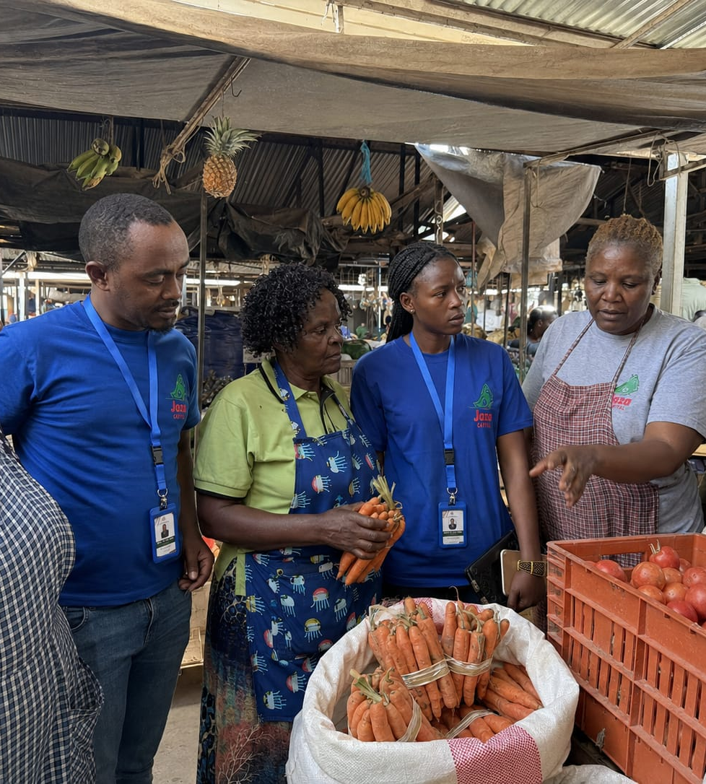
Pillar 2 | Inclusive Finance & Catalytic Capital
Build financial wellbeing through savings, responsible finance, investment readiness and capital matched to enterprise reality.
Savings & buffers
Strengthen financial discipline, shock preparedness and business reserves.
Suitable finance
Align purpose, amount, timing, tenor and repayment with verified cash flow.
Investment pathways
Prepare enterprises for productive assets, repeat finance and suitable onward investment.
Catalytic capital
Use partner-funded facilities, guarantees or risk-sharing only with explicit rules and reporting.
Inclusion does not mean unsuitable debt. Non-credit support, savings-led growth or responsible decline can be valid programme outcomes.
Enterprise and cash-flow engagement | Kenya, 2026
Notes:
[Sources]
- Internal: JIFI Capability Deck 2026, slides 10–12
- Internal: Jaza Capital JIFI Data Collection and Feasibility Report, sections 4, 7 and 11
[/Sources]

Slide 7

Pillar 3 | Market Systems & Value Chains
Expand economic opportunity by strengthening the relationships, services and transactions around the enterprise.
MARKETS
FINANCE
Buyers, processors, traders and repeat demand
Banks, MFIs, guarantees, insurers and investors
LAST-MILE
ENTERPRISE
SERVICES
ENABLERS
Technical, business, digital and data providers
Counties, policy actors, infrastructure and standards
Market engagement | Kenya, 2026
JIFI identifies the binding constraint, convenes actors with an incentive to solve it and supports relationships that can continue beyond the programme.
Notes:
[Sources]
- Internal: JIFI Capability Deck 2026, slides 6–8
- Internal: Jaza Capital JIFI Data Collection and Feasibility Report, sections 6–8
[/Sources]

Slide 8

Pillar 4 | Women, Youth & Underserved Inclusion
Design for meaningful participation, benefit, agency and equitable access to economic opportunity.
Reach
Participation
Use transparent eligibility and accessible mobilisation to reach the intended groups.
Remove practical barriers affecting entry, completion and use of services.
Agency and control
Benefit and protection
Measure voice, decision-making and control of income and productive assets.
Track who gains, whether workloads or risks increase, and how issues are resolved.
Development standard
Participation numbers are not enough. JIFI will assess who benefits, who controls resources and whether programme delivery is safe and equitable.
Participant engagement | Kenya, 2026
Notes:
[Sources]
- Internal: JIFI Capability Deck 2026, slides 3 and 13
- Internal: Jaza Capital JIFI Data Collection and Feasibility Report, sections 4, 9 and 10
[/Sources]

Slide 9

Pillar 5 | Climate Resilience & Green Enterprise
Reduce exposure to climate and environmental risk while enabling commercially viable green and resilient enterprise solutions.
Risk screening
Resilient practices
Understand climate exposure, livelihood sensitivity and the enterprise’s capacity to respond.
Support practical actions that protect production, assets, supply and income.
Green productive assets
Risk finance and insurance
Enable viable energy, water, cold-chain, processing and loss-reduction investments.
Use savings, insurance and risk-sharing where the design and economics justify them.
Measure adoption, productive use and verified resilience benefit, not only the number of green assets financed.
Value-chain field engagement | Kenya, 2026
Notes:
[Sources]
- Internal: JIFI Capability Deck 2026, slides 8, 10, 13 and 15
[/Sources]

Slide 10
Pillar 6 | Evidence, Learning & Delivery Assurance
Give commissioners confidence that resources, delivery quality, participant protection and outcomes are visible and used for decisions.
01 BASELINE
02 LIVE DELIVERY
03 OUTCOME REVIEW
04 DECISION
Enterprise, household, market and risk starting point
→
Participation, support, finance use and service quality
→
Performance, financial health, market and resilience
→
Stop, adapt, scale, transfer or transition
Finance fit
Enterprise outcomes
Financial health
Market participation
Inclusion and agency
Climate resilience
Safeguarding and complaints
Value for money
Evidence is an operating tool: agree definitions early, review regularly, document adaptations and maintain a clear audit trail.
Notes:
[Sources]
- Internal: JIFI Capability Deck 2026, slide 14
- Internal: Jaza Capital JIFI Data Collection and Feasibility Report, sections 9–12
- FCDO Programme Operating Framework and Supply Partner Code principles as summarised in the thread
[/Sources]

Slide 11
How JIFI delivers: a repeatable implementation method
The DELIVERS framework converts a development mandate into a controlled participant journey and evidence-based scale decision.
D
Diagnose
E
Engage
L
Link finance
I
Integrate
Problem, market, participants and baseline
Transparent targeting, consent and segmentation
Match capital to enterprise need and affordability
Technical support, markets and specialist partners
V
Verify
E
Evidence
R
Review
S
Scale
Safeguards, controls, quality and participant feedback
Outcomes, additionality and value for money
Learn, adapt and document decisions
Expand, transfer or transition what works
Every stage has a defined owner, evidence requirement, decision point and participant-protection boundary.
Notes:
[Sources]
- Internal: JIFI strategic repositioning discussion, DELIVERS framework
[/Sources]

Slide 12

The participant journey links inclusion to improved livelihoods
Finance enters at the right point in a sequenced pathway, and progression is defined by the enterprise’s next viable step.
1 Identify
2 Segment
3 Diagnose
4 Prepare
Transparent eligibility
Role, maturity and vulnerability
Cash flow and binding constraints
Records and support plan
5 Finance
6 Connect
7 Measure
8 Progress
Suitable capital or non-credit path
Markets, suppliers and services
Enterprise, participant and market outcomes
Repeat, onward or independent finance
Successful progression may mean stronger savings, better records, market access, suitable finance or stable self-financed growth.
Enterprise journey | Kenya, 2026
Notes:
[Sources]
- Internal: JIFI Capability Deck 2026, slide 9
- Internal: Jaza Capital JIFI Data Collection and Feasibility Report, section 4.3
[/Sources]

Slide 13
One delivery architecture. Clear roles. Visible accountability.
JIFI integrates the programme while capital, technical support, market functions and assurance remain explicitly governed.
PARTNER MANDATE
PROGRAMME RESOURCES
MARKET & TECHNICAL ACTORS
JAZA PLATFORM
Outcomes, target segment, eligible uses and evidence standard
Participant capital, technical assistance, delivery and evidence
Buyers, specialists, insurers, researchers and public actors
Branches, enterprise relationships, credit rails, data and servicing
JIFI PROGRAMME INTEGRATION
Programme design • participant journey • partner coordination • safeguards • resource administration • reporting and learning
PARTICIPANT CAPITAL
TECHNICAL ASSISTANCE
DELIVERY FEES
MEL & ASSURANCE
RISK ARRANGEMENT
Separate use, ledger and reporting
Specialist and enterprise support
Field execution and case management
Baseline, data quality, safeguards and outcomes
Only where contracted and defined
Notes:
[Sources]
- Internal: JIFI Capability Deck 2026, slide 11
- Internal: Jaza Capital JIFI Data Collection and Feasibility Report, sections 9 and 11
[/Sources]

Slide 14
Jaza’s operating platform makes last-mile delivery practical
JIFI uses existing financial and field infrastructure while adding ring-fenced programme capabilities and partner assurance.
17
10
reported branch delivery points
counties with direct presence
104
41,264
staff across field, credit and operations
recorded disbursements, not unique enterprises
FIELD | Local sourcing, visits and relationships
CREDIT | Assessment, approval, disbursement and servicing
DATA | Central records, transaction history and performance visibility
REACH | Direct engagement with predominantly women-led nano and micro enterprises
Jaza field engagement | Kenya, 2026
Assurance condition: reconcile platform figures and independently test governance, system access, portfolio definitions and financial controls before external commitments or scale.
Notes:
[Sources]
- Internal: JIFI Capability Deck 2026, slide 5
- Internal: Jaza Capital JIFI Data Collection and Feasibility Report, executive summary and sections 3, 5 and 12
[/Sources]

Slide 15
Outcomes partners can commission and verify
Programmes are designed backward from the development change they must produce.
Enterprise performance
Financial wellbeing
Productivity, value addition, sales, margins, assets and continuity
Savings, buffers, debt stress and suitable investment progression
Women’s economic participation
Youth opportunity and jobs
Benefit, voice, agency and control of income and assets
Viable roles, enterprise services, job creation and decent work
Market participation
Climate resilience
Buyers, suppliers, standards, repeat transactions and reduced losses
Reduced risk exposure and productive green or resilient asset use
Ultimate development result: improved livelihoods and stronger, more resilient communities.
Notes:
[Sources]
- Internal: JIFI Capability Deck 2026, slides 13–14
- Internal: Jaza Capital JIFI Data Collection and Feasibility Report, section 10
[/Sources]

Slide 16
Partners can commission the level of support their mandate requires
Each route produces a defined scope, delivery team, budget, capital boundary, evidence standard and decision point.
END-TO-END PROGRAMME
DELIVERY LAYER AROUND CAPITAL
DIAGNOSTIC & PROGRAMME DESIGN
JIFI designs and coordinates a complete inclusive-enterprise, livelihoods or value-chain programme from diagnosis and participant selection through support, finance, market linkage, safeguards and outcomes.
JIFI adds last-mile targeting, needs assessment, enterprise support, market connections, participant protection and outcome evidence around a bank, DFI, guarantee or partner facility.
JIFI screens the opportunity, validates assumptions and produces the theory of change, intervention logic, instrument mix, implementation plan, budget, risk framework and measurement approach.
Initial commissioning options
Controlled pilot
Consortium delivery
Last-mile implementation
Diagnostic to conditional implementation
Participant capital, technical assistance, delivery, monitoring and any risk arrangement are separately specified and costed.
Notes:
[Sources]
- Internal: JIFI Capability Deck 2026, slide 16
- Internal: JIFI consolidated readiness assessment and commissioning recommendations
[/Sources]

Slide 17
JAZA INCLUSIVE FINANCE INITIATIVE
Define the development outcome.
Build the delivery pathway.
A focused design conversation starts with four questions:
1
What change should the programme produce?
2
Who should benefit, and what barriers must be addressed?
3
What capital, services and market relationships are required?
4
What evidence will trigger adaptation, scale or transition?
MANDATE-TO-DELIVERY DESIGN SESSION
Jaza field engagement | Kenya, 2026
Notes:
[Sources]
- Internal: JIFI Capability Deck 2026, slide 17
- Internal: JIFI strategic repositioning discussion
[/Sources]

